Slide 1

WES237B: Software for Embedded Systems
Pat Pannuto
Department of Computer Science and Engineering
University of California, San Diego
Summer Session 2022

Slide 2
Today
Morning
Parallel Programming Patterns
Streaming Programming Patterns
Deep Learning (Lite)
Afternoon+
Lab session
Applied Deep Learning
Assignment
Ain’t that a question

Slide 3
Logistics
Assignment 4 due tomorrow
Assignment 5 released
Generally: First bit of assignment is lab portion, the rest is take-home
Finish the lab first if needed
Late policy?
1 week: 10% off
2 weeks: Last chance, 30% off
Email with any exceptional circumstances, we’ll work it out

Slide 4
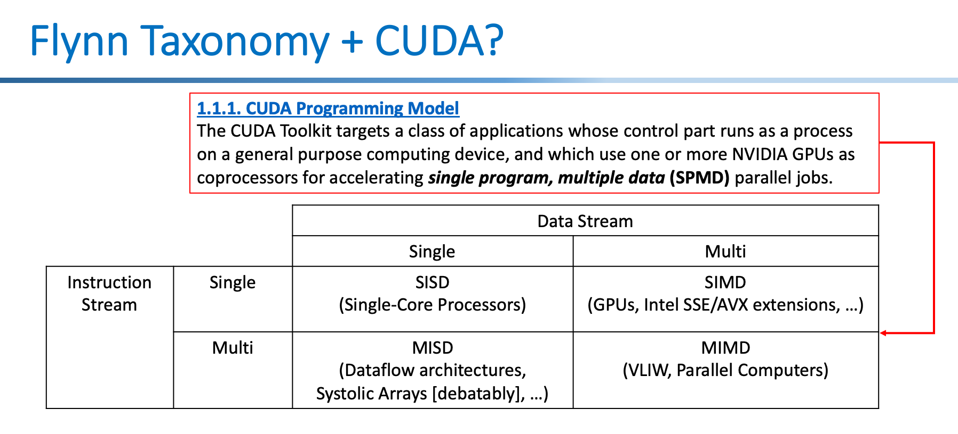
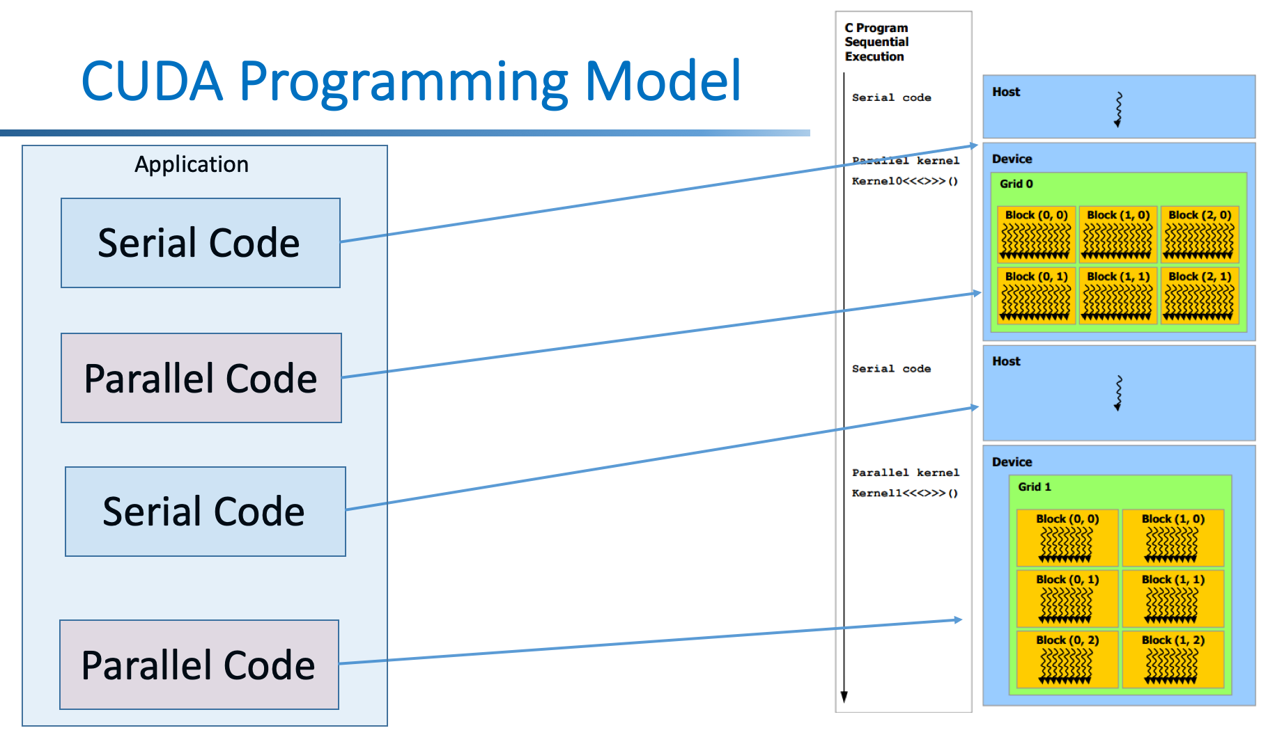
Recap
SIMD, SPMD, MIMD & Flynn’s Taxonomy
Ways to describe ‘how parallel’ execution is
Expresses hardware capability, software engineer has to figure how to use it well
CUDA
Varying units of parallelism and flexibility
Threads, warps, blocks, grids
CUDA Memory
Performance highly dependent on memory management
Still heavily manual process :/

Slide 5
Limitations of Optimizing Compilers
Operate under fundamental constraint
Must not cause any change in program behavior
Except, possibly when program making use of nonstandard language features
Behavior that may be obvious to the programmer can be obfuscated by languages and coding styles
e.g., Data ranges may be more limited than variable types suggest
Most analysis is performed only within procedures
Whole-program analysis is too expensive in most cases
Newer versions of GCC do interprocedural analysis within individual files
But, not between code in different files
Most analysis is based only on static information
Compiler has difficulty anticipating run-time inputs
When in doubt, the compiler must be conservative​
Bryant and O'Hallaron, Computer Systems: A programmer's Perspective

Slide 6
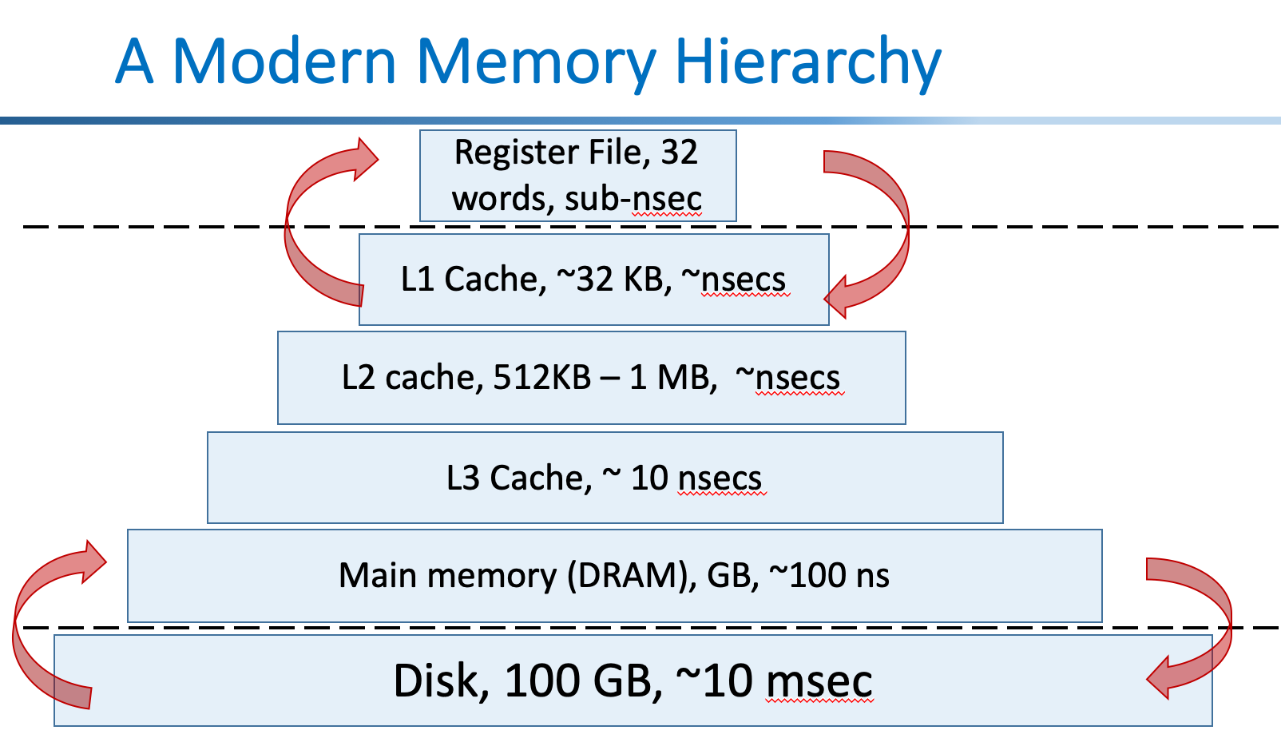
The guts of most interesting stuff is often ~this
void Foo(float* const A, float* const B, float* const C, const int M, const int N, const int K)
{
for (int m = 0; m < M; m++) {
for (int n = 0; n < N; n++) {
for (int k = 0; k < K; k++) {
C[m * M + n] += A[m * M + k] * B[k * K + n];
}
}
}
}
Lab2: image.tif
480x640 pixels * 4 bytes/float ~= 1.3 MB (greyscale!)
And these are huge
Notes:
Not literally these loops, but multi-dimensional math, which boils down to loops of basic op’s marching through arrays

Slide 7
Parallel Programming Patterns
… could we not deal with all this HW knowledge, please?

Slide 8
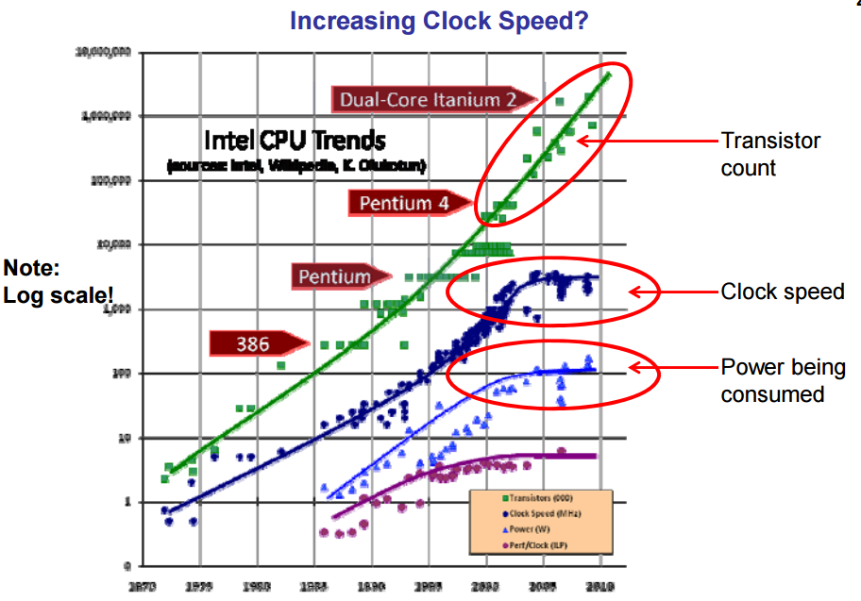
Frequency Scaling

Slide 9
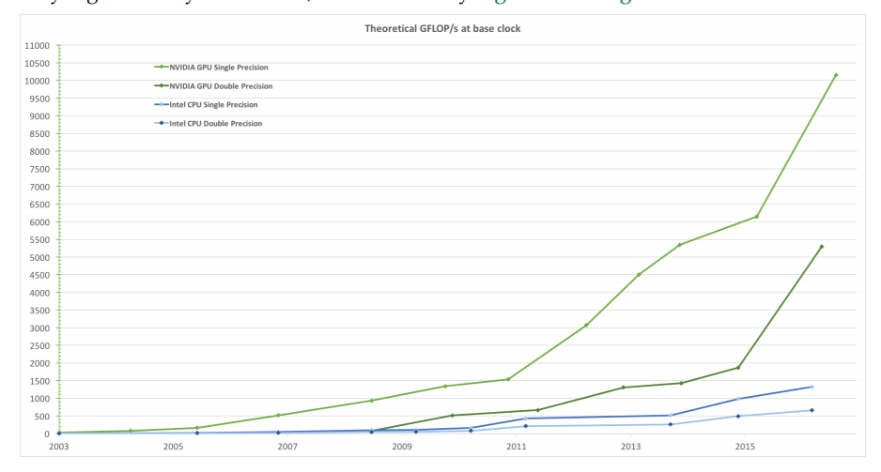
Floating-Point Operations/Second

Slide 10
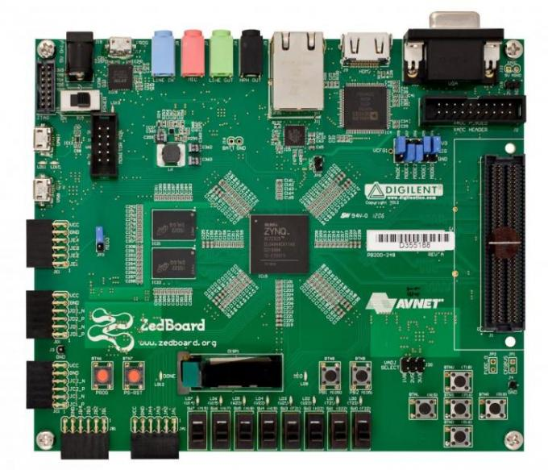
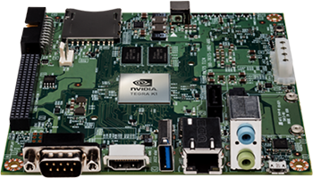
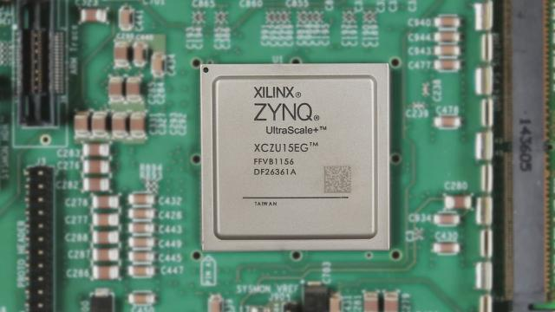
Frequency vs. Parallelism
Single CPU performance
Doubled every 2 years for 30 years; stopped around 2006
Marginal improvement since around 2006
Solution ➔ Parallelism (Heterogeneous Parallel Programming)
Does (Heterogeneous) Parallel Programming Matter for Embedded Systems ?
ARM +FPGA
ARM +GPU
ARM +Graphics Processor + FPGA

Slide 11
Parallelism ?
Parallelism is achieved by partitioning or decomposing an application into serial & parallel parts
How to know where the parallelism is?
How to write parallel programs?

Slide 12
Parallelism → Decomposition
Application
Defining Requirements
Defining Specification
Partition
Parallel
Sequential
System Integration & Testing

Slide 13
Parallel Programming is

Slide 14
Parallel Programming is Difficult!

Slide 15
Some are harder than others,..
void vecvecmul(int N,int *a, int *b, int *c){
int b=0,a=0;
int sum=0;
for(int i=0;i<N;i++){
c[i]=a[i]*b[i];
}

Slide 16
Some are harder than others,..
void vecvecmul(int N,int *a, int *b, int *c){
int b=0,a=0;
int sum=0;
for(int i=0;i<N;i++){
c[i]=a[i]*b[i];
}
void prefixsum(int in[SIZE], int out[SIZE]){
out[0] = in[0];
for(int i = 1; i < SIZE; ++i)
{
out[i] = out[i-1] + in[i];
}
}

Slide 17
Some are harder than others,..
void vecvecmul(int N,int *a, int *b, int *c){
int b=0,a=0;
int sum=0;
for(int i=0;i<N;i++){
c[i]=a[i]*b[i];
}
void Foo(DTYPE numbers[n])
{
int i, j, index;
for (i=1; i < n; i++)
{
index = numbers[i];
j = i;
while ((j > 0)&& (numbers[j-1] > index) )
{
numbers[j] = numbers[j-1];
j = j - 1;
}
numbers[j] = index;
}
}
void prefixsum(int in[SIZE], int out[SIZE]){
out[0] = in[0];
for(int i = 1; i < SIZE; ++i)
{
out[i] = out[i-1] + in[i];
}
}

Slide 18
A Number of Platforms and Programming Models
Platforms
Multicores
GPUs
FPGAs
…
Programming models, libraries & languages
CPU
Pthreads
OpenMP
GPU
CUDA
OpenCL
FPGA
Models: streaming, pipeline, dataflow pipeline,…
Languages: Verilog, VHDL, HLS, OpenCL, Chisel, FCUDA

Slide 19
Mapping serial application to parallel platform
Parallel Platform
(GPU or FPGA or,..CPU)
Application
Automatic to some degree
Parallel Programming Environment→ Another Parallel Programming environment
Manually decomposing parallelism & Mapping it into a parallel platform

Slide 20
Mapping serial application to parallel platform
Automatic to some degree (usually using pragmas)
E.g., OpenMP or HLS
Parallel Platform
(GPU or FPGA or,..CPU)
Application

Slide 21
Mapping serial application to parallel platform
Automatic to some degree (usually using pragmas)
E.g., OpenMP or HLS
Parallel Platform
(GPU or FPGA or,..CPU)
Application
void vecvecmul(int N,int *a, int *b, int *c){
int b=0,a=0;
int sum=0;
for(int i=0;i<N;i++){
c[i]=a[i]*b[i];
}

Slide 22
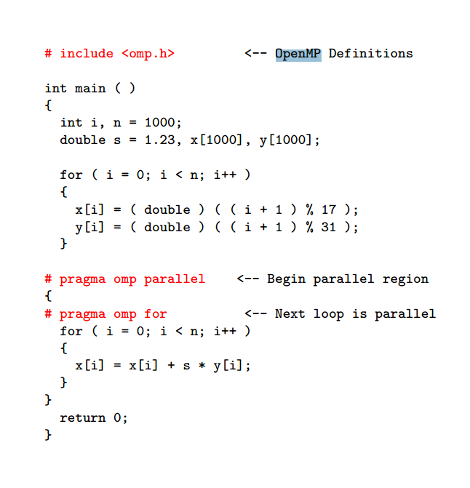
Mapping serial application to parallel platform
OpenMP→CUDA
CUDA Code
CPU Code
__global__ void saxpy(int n, float a, float *x, float *y)
{
int i = blockIdx.x*blockDim.x + threadIdx.x;
if (i < n) y[i] = a*x[i] + y[i];
}

Slide 23
Mapping serial application to parallel platform
void Foo(DTYPE numbers[n])
{
int i, j, index;
for (i=1; i < n; i++)
{
index = numbers[i];
j = i;
while ((j > 0)&& (numbers[j-1] > index) )
{
numbers[j] = numbers[j-1];
j = j - 1;
}
numbers[j] = index;
}
}
Parallel Platform
(GPU or FPGA or,..CPU)
Most of the time programmer must modify the code so that it maps well to target platform → Difficult, time consuming
There are some best practices & and parallel programming models

Slide 24
Structured Parallel Patterns
The following additional parallel patterns can be used for “structured parallel programming”:
Superscalar sequence
Speculative selection
Map
Recurrence
Scan
Reduce
Pack/expand
Fork/join
Pipeline
Partition
Segmentation
Stencil
Search/match
Gather
Merge scatter
Priority scatter
*Permutation scatter
!Atomic scatter
Using these patterns, threads and vector intrinsics can (mostly) be eliminated and the maintainability of software improved.
This slide is from :McCool et al, “Structured Parallel Programming: Patterns for Efficient Computation” – Full Presentation
24
Notes:
Most mutexes and semaphores can be eliminated too. Semaphores are truly the “goto” of parallel programming, since a “signal” operation causes a “wait” operation somewhere else to return.

Slide 25
Parallel Patterns
Parallel Pattern for Convolution
Parallel Pattern for Prefix sum
Parallel Pattern for Histogram Computation
Parallel Pattern for Sparse Matrix Computation
Parallel Pattern for Merge/Quick Sort

Slide 26
Parallel Programming Patterns
f
Bulk Synchronous
Fork/Join
MapReduce
Sliding Window
Blocking
Reduction

Slide 27
Blocking: Matrix*Matrix operations
a₁₁
a₁₂
a₁₃
a₁₄
b₁₁
b₁₂
b₁₃
b₁₄
b₁₁
b₁₂
a₂₁
a₂₂
a₂₃
a₂₄
b₂₁
b₂₂
b₂₃
b₂₄
b₂₁
b₂₂
a₃₁
a₃₂
a₃₃
a₃₄
b₃₁
b₃₂
b₃₃
b₃₄
b₃₁
b₃₂
a₄₁
a₄₂
a₄₃
a₄₄
b₄₁
b₄₂
b₄₃
b₄₄
b₄₁
b₄₂
stream 2
x
c₁₁
c₁₂
c₁₃
c₁₄
a₁₁*b₁₁
+
a₁₂*b₂₁
+
a₁₃*b₃₁
+
a₁₄*b₄₁
=
c₁₁
c₂₁
c₂₂
c₂₃
c₂₄
a₁₁*b₁₂
+
a₁₂*b₂₂
+
a₁₃*b₃₂
+
a₁₄*b₄₂
=
c₁₂
c₃₁
c₃₂
c₃₃
c₃₄
stream 1
c₄₁
c₄₂
c₄₃
c₄₄
a₁₁
a₁₂
a₁₃
a₁₄
a₂₁*b₁₁
+
a₂₂*b₂₁
+
a₂₃*b₃₁
+
a₂₄*b₄₁
=
c₂₁
a₂₁
a₂₂
a₂₃
a₂₄
c₂₂
a₂₁*b₁₂
+
a₂₂*b₂₂
+
a₂₃*b₃₂
+
a₂₄*b₄₂
=

Slide 28
Prefix sum Serial Code
Input:
0
2
1
6
3
1
2
5
void prefixsum(I_TYPE in[SIZE], I_TYPE out[SIZE]){
for(int i = 1; i < SIZE; ++i){
out[i] = out[i-1] + in[i];
}
}
Output:
0
2
3
9
12
13
15
20

Slide 29
Parallel Pattern for Prefix Sum
0
2
1
6
3
1
2
5
Stage 1
temp1
0
2
3
7
9
4
3
7
temp2
Stage 2
0
2
3
9
12
11
12
11
temp3
Stage 3
0
2
3
9
12
13
15
20

Slide 30
Mapping to BulkSynchronous Pattern
1 | 2 | 3
 |  | 2
9 | 9 | 9
6 | 0 | 9
1 | 1 | 1
1 | 2 | 3
0 | 0 | 2
9 | 9 | 9
6 | 0 | 9
1 | 1 | 1
1 | 1 | 1
0 | 0 | 2
1 | 2 | 3
9 | 9 | 9
6 | 0 | 9
6 | 0 | 9
0 | 0 | 2
1 | 1 | 1
1 | 2 | 3
9 | 9 | 9
0 | 0 | 2
1 | 1 | 1
1 | 2 | 3
6 | 0 | 9
9 | 9 | 9

Slide 31
Mapping to BulkSynchronous Pattern
1 | 2 | 3
 |  | 2
9 | 9 | 9
6 | 0 | 9
1 | 1 | 1
1 | 2 | 3
0 | 0 | 2
9 | 9 | 9
6 | 0 | 9
1 | 1 | 1
1 | 1 | 1
0 | 0 | 2
1 | 2 | 3
9 | 9 | 9
6 | 0 | 9
6 | 0 | 9
0 | 0 | 2
1 | 1 | 1
1 | 2 | 3
9 | 9 | 9
0 | 0 | 2
1 | 1 | 1
1 | 2 | 3
6 | 0 | 9
9 | 9 | 9
(b) Radix sort
1. Counting sort
Mem(n)
2. Counting sort
Mem(n)
3. Counting sort
Mem(n)
4. Counting sort

Slide 32
Mapping serial application to parallel platform
void InsertionSort(DTYPE numbers[n])
{
int i, j, index;
for (i=1; i < n; i++)
{
index = numbers[i];
j = i;
while ((j > 0)&& (numbers[j-1] > index) )
{
numbers[j] = numbers[j-1];
j = j - 1;
}
numbers[j] = index;
}
}
Parallel Platform
(GPU or FPGA or,..CPU)
Serial Code → Streaming Models

Slide 33
Streaming Programming ?

Slide 34
Insertion Sort
3
2
5
1

Slide 35
Insertion Sort
3
2
5
1

Slide 36
Insertion Sort
3
2
5
1
3
2
5
1

Slide 37
Insertion Sort
3
2
5
1
3
2
5
1

Slide 38
Insertion Sort
3
2
5
1
3
2
5
1
2
3
5
1

Slide 39
Insertion Sort
3
2
5
1
3
2
5
1
2
3
5
1

Slide 40
Insertion Sort
3
2
5
1
3
2
5
1
2
3
5
1
2
3
5
1

Slide 41
Insertion Sort
3
2
5
1
3
2
5
1
2
3
5
1
2
3
5
1

Slide 42
Insertion Sort
3
2
5
1
void InsertionSort(DTYPE numbers[n])
{
int i, j, index;
for (i=1; i < n; i++)
{
index = numbers[i];
j = i;
while ((j > 0)&& (numbers[j-1] > index) )
{
numbers[j] = numbers[j-1];
j = j - 1;
}
numbers[j] = index;
}
}
3
2
5
1
2
3
5
1
2
3
5
1
1
2
3
5

Slide 43
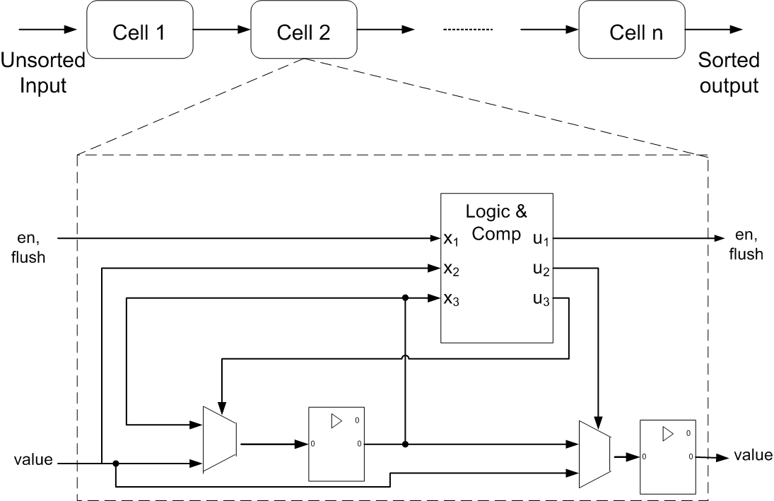
Insertion Sort: Streaming

Slide 44
Insertion Sort: Streaming
1
5
2
3
5
3
2
1

Slide 45
Insertion Sort: Streaming
1
5
2
3

Slide 46
Insertion Sort: Streaming
1
5
2
3

Slide 47
Insertion Sort: Streaming
1
5
3
2

Slide 48
Insertion Sort: Streaming
1
5
3
2

Slide 49
Insertion Sort: Streaming
1
5
3
2

Slide 50
Insertion Sort: Streaming
1
5
2
3
5
3
2
1
Streaming Core
There is a plethora of work on parallel soring algorithms (computational patterns are very different from what we learned from
Our algorithms class)
Bitonic sort, parallel merge (quick) sort,…

Slide 51


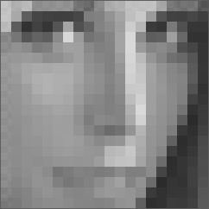
Sliding Window: Convolution
-1 | 0 | +1
-2 | 0 | +2
-1 | 0 | +1
+1 | +2 | +1
0 | 0 | 0
-1 | -2 | -1
Magnification
G_X = 1*(-1) + 2*0 + 3*1 +…+ = 8
G_Y = 1*(-1) + 2*2 +3*1 + … + = -32
G=sqrt(G_X² + G_Y²)
for(int i = 0; i < rows; i++){
for(int j=0; j < cols; j++){
G_{x} = 0;
G_{y} = 0;
for(int rowOffset = -1; rowOffset <= 1; rowOffset++){
for(int colOffset = -1; colOffset <=1; colOffset++){
G_{x} = G_{x} + …;
G_{y} = G_{y} + …;
G = …;
}
}
}
}

Slide 52
Sliding Window: Convolution
for(int i = 0; i < rows; i++){
for(int j=0; j < cols; j++){
G_{x} = 0;
G_{y} = 0;
for(rowOffset = -1; rowOffset <= 1; rowOffset++){
for(colOffset = -1; colOffset <=1; colOffset++){
G_{x} = G_{x} + …;
G_{y} = G_{y} + …;
G = …;
}
}
}
}
Based on Xilinx tutorial: “Zynq all programmable soc sobel filter implementation using the vivado hls tool.”

Slide 53
Sliding Window: Convolution
New data
Window Buffer
Kernel
Computation
Line Buffer
Window Buffer 1
1
2
3
4
1
2
3
5
6
7
8
5
6
7
9
10
11
12
9
10
11
13
14
15
16
Input Image

Slide 54
Sliding Window: Convolution
New data
Window Buffer
Kernel
Computation
Line Buffer
Window Buffer 1
Window Buffer 2
1
2
3
4
1
2
3
2
3
4
5
6
7
8
5
6
7
6
7
8
9
10
11
12
9
10
11
10
11
12
13
14
15
16
Input Image

Slide 55
Sliding Window: Convolution
New data
Window Buffer
Kernel
Computation
Line Buffer
Line Buffer at time t
Window Buffer 1
Window Buffer 2
1
2
3
4
Line 1
1
2
3
4
1
2
3
2
3
4
5
6
7
8
Line 2
5
6
7
8
5
6
7
6
7
8
9
10
11
12
Line 3
9
10
11
12
9
10
11
10
11
12
13
14
15
16
Input Image

Slide 56
Sliding Window: Convolution
New data
Window Buffer
Kernel
Computation
Line Buffer
Line Buffer at time t
Window Buffer 1
Window Buffer 2
1
2
3
4
Line 1
1
2
3
4
1
2
3
2
3
4
5
6
7
8
Line 2
5
6
7
8
5
6
7
6
7
8
9
10
11
12
Line 3
9
10
11
12
9
10
11
10
11
12
13
14
15
16
Input Image

Slide 57
Sliding Window: Convolution
New data
Window Buffer
Kernel
Computation
Line Buffer
Line Buffer at time 0
Line Buffer at time t
Window Buffer 1
Window Buffer 2
1
2
3
4
Line 1
1
2
3
4
1
2
3
2
3
4
5
6
7
8
Line 2
5
6
7
8
5
6
7
6
7
8
9
10
11
12
Line 3
9
10
11
12
9
10
11
10
11
12
13
14
15
16
Input Image

Slide 58
Sliding Window: Convolution
New data
Window Buffer
Kernel
Computation
Line Buffer
Line Buffer at time 0
Line Buffer at time t
Window Buffer 1
Window Buffer 2
1
2
3
4
Line 1
1
2
3
4
1
2
3
2
3
4
5
6
7
8
Line 2
5
6
7
8
5
6
7
6
7
8
9
10
11
12
Line 3
1
9
10
11
12
9
10
11
10
11
12
13
14
15
16
Input Image

Slide 59
Sliding Window: Convolution
New data
Window Buffer
Kernel
Computation
Line Buffer
Line Buffer at time 0
Line Buffer at time t
Window Buffer 1
Window Buffer 2
1
2
3
4
Line 1
1
2
3
4
1
2
3
2
3
4
5
6
7
8
Line 2
5
6
7
8
5
6
7
6
7
8
9
10
11
12
Line 3
1
2
9
10
11
12
9
10
11
10
11
12
13
14
15
16
Input Image
In GPU, Convolution is usually done using matrix multiplication

Slide 60
Scalability & Portability
Scalability
The same application runs efficiently on new generations of cores
The same application runs efficiently on more of the same cores
The same application runs on hardware with different number of resources
Portability
The same application runs efficiently on hardware with different number of resources

Slide 61
Deep Learning in half a morning ☺

Slide 62
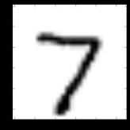
Deep Learning
Deep Learning
“Seven”
Output layer
Input layer
Hidden layers

Slide 63

Deep Learning
Deep Learning
“Seven”
Output layer
Input layer
Hidden layers

Slide 64
Deep Learning
“Seven”
Output layer
Input layer
Hidden layers
Neural Networks

Slide 65
Deep Learning
J^{th}
“Seven”
Output layer
Input layer
Hidden layers
Neural Networks

Slide 66
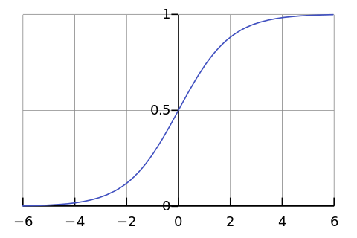
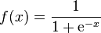
The Neuron Model
x₁
w_{1j}
y_{j}
w_{2j}
x₂
w_{nj}
x_{n}

Slide 67
Deep Learning
W¹
W²
W³
“Seven”
Output layer
Input layer
Hidden layers
Learning → Adjusting Weights!

Slide 68
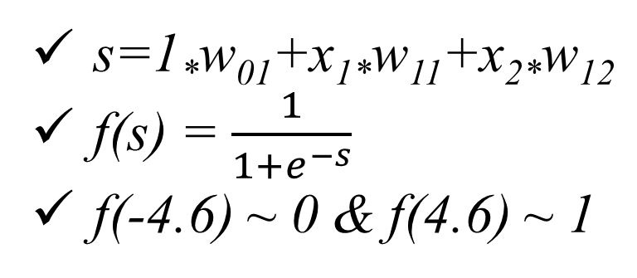
Learning: Neural Network
+1
w₀₁
x₁ | x₂ | s | y=f(s) | Output
0 | 0 |  |  | 0
0 | 1 |  |  | 0
1 | 0 |  |  | 0
1 | 1 |  |  | 1
w₁₁
^{AND}
y=f(s)
x₁
x₂
w₁₂
s=1*w₀₁+x_{1*}w₁₁+x_{2*}w₁₂
f(s) = $\frac{1}{1+e^{−s}}$
f(-4.6) ~ 0 & f(4.6) ~ 1
Learning → Adjusting Weights!

Slide 69
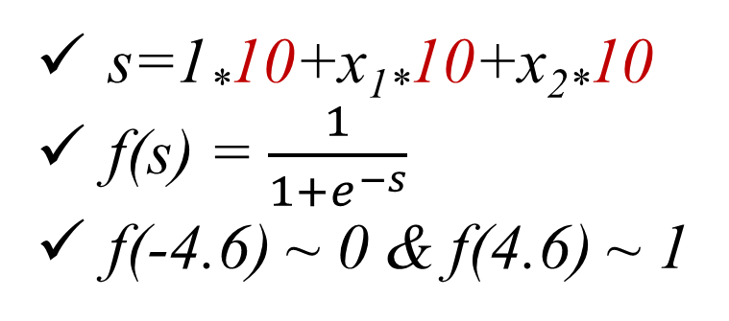
Learning: Neural Network
+1
w₀₁=10
x₁ | x₂ | s | y=f(s) | Output
0 | 0 |  |  | 0
0 | 1 |  |  | 0
1 | 0 |  |  | 0
1 | 1 |  |  | 1
w₁₁=10
^{AND}
y=f(s)
x₁
x₂
w₁₂=10
s=1*10+x_{1*}10+x_{2*}10
f(s) = $\frac{1}{1+e^{−s}}$
f(-4.6) ~ 0 & f(4.6) ~ 1
Learning → Adjusting Weights!

Slide 70
Learning: Neural Network
+1
w₀₁=10
x₁ | x₂ | s | y=f(s) | Output
0 | 0 | 10 |  | 0
0 | 1 | 20 |  | 0
1 | 0 | 20 |  | 0
1 | 1 | 30 |  | 1
w₁₁=10
^{AND}
y=f(s)
x₁
x₂
w₁₂=10
s=1*10+x_{1*}10+x_{2*}10
f(s) = $\frac{1}{1+e^{−s}}$
f(-4.6) ~ 0 & f(4.6) ~ 1
Learning → Adjusting Weights!

Slide 71
Learning: Neural Network
+1
w₀₁=10
x₁ | x₂ | s | y=f(s) | Output
0 | 0 | 10 | 1 | 0
0 | 1 | 20 | 1 | 0
1 | 0 | 20 | 1 | 0
1 | 1 | 30 | 1 | 1
w₁₁=10
^{AND}
y=f(s)
x₁
x₂
w₁₂=10
s=1*10+x_{1*}10+x_{2*}10
f(s) = $\frac{1}{1+e^{−s}}$
f(-4.6) ~ 0 & f(4.6) ~ 1
Learning → Adjusting Weights!

Slide 72
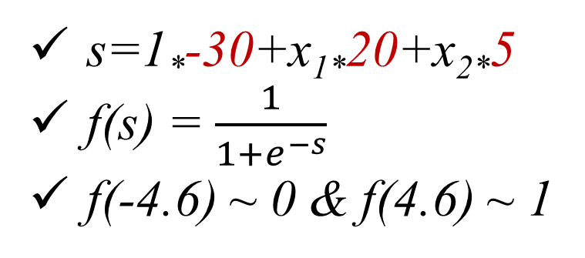
Learning: Neural Network
+1
w₀₁=-30
x₁ | x₂ | s | y=f(s) | Output
0 | 0 | -30 | 0 | 0
0 | 1 | -20 | 0 | 0
1 | 0 | -10 | 0 | 0
1 | 1 | -5 | 0 | 1
w₁₁=20
^{AND}
y=f(s)
x₁
x₂
w₁₂=5
s=1*-30+x_{1*}20+x_{2*}5
f(s) = $\frac{1}{1+e^{−s}}$
f(-4.6) ~ 0 & f(4.6) ~ 1
Learning → Adjusting Weights!

Slide 73
Learning: Neural Network
+1
w₀₁=-30
x₁ | x₂ | s | y=f(s) | Output
0 | 0 | -30 | 0 | 0
0 | 1 | -10 | 0 | 0
1 | 0 | -10 | 0 | 0
1 | 1 | 10 | 1 | 1
w₁₁=20
^{AND}
y=f(s)
x₁
x₂
w₁₂=20
s=1*-30+x_{1*}20+x_{2*}5
f(s) = $\frac{1}{1+e^{−s}}$
f(-4.6) ~ 0 & f(4.6) ~ 1
Learning → Adjusting Weights!

Slide 74
Learning Non-Linear Functions (MLP)
+1
30
+1
10
+1
-10
20
y
-20
y
20
y
x₁
x₁
x₁
20
-20
20
x₂
x₁ & x₂
x₂
~x₁ & ~x₂
x₂
x₁ | x₂
+1
x₁ | x₂ | a | b | Output
0 | 0 | 0 | 1 | 1
0 | 1 | 0 | 0 | 0
1 | 0 | 0 | 0 | 0
1 | 1 | 1 | 0 | 1
30
-10
ª
+1
20
20
20
y
x₁
10
-20
x₂
-20
20
^{b}

Slide 75
Convolutional Neural Networks (CNN)
32x32x3
5x5x3
Convolution (Conv)

Slide 76
Convolutional Neural Networks (CNN)
32x32x3
5x5x3
Convolution (Conv)

Slide 77
Convolutional Neural Networks (CNN)
32x32x3
6 of 5x5x3
28
28
Convolution (Conv)
6

Slide 78
Convolutional Neural Networks (CNN)
32x32x3
6 5x5x3
28x28x6
Convolution (Conv)
ReLU = max(0,x)
Pooling
Example of CNN = {Conv, ReLU, Pooling}, {Conv, ReLU, Pooling},…

Slide 79
Datasets
The MNIST
http://yann.lecun.com/exdb/mnist/
The CIFAR-10
https://www.cs.toronto.edu/~kriz/cifar.html
The Street View House Numbers (SVHN)
http://ufldl.stanford.edu/housenumbers/
ImageNet
14,197,122 images
http://image-net.org/

Slide 80
Specific Examples of CNN Implementation

Slide 81
CIFFAR Test Topology
32@3x3x3
32@32x3x3
64@32x3x3
64@64x3x3
128@64x3x3
32x32x3
pool
pool
32x32x32
32x32x32
32x16x16
64x16x16
64x16x16
64x8x8
128x8x8
128@128x3x3
pool
128x8x8
128x4x4
512
10
2048
1024

Slide 82
Convolutional Net using CIFFAR: The first Layer
Input: 32x32x3
Filters: 32 of 3x3x3
Output shape: 32x32x32
32
32
32 of 3x3x3 filters
32
Convolution (Conv)

Slide 83
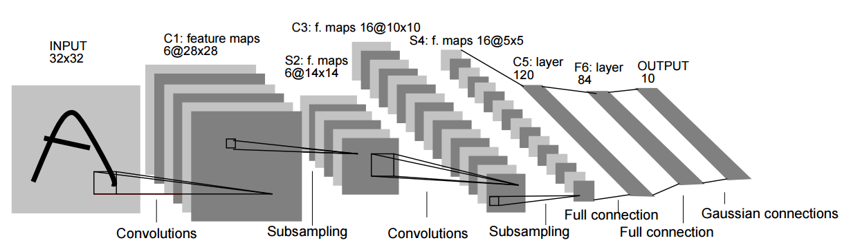
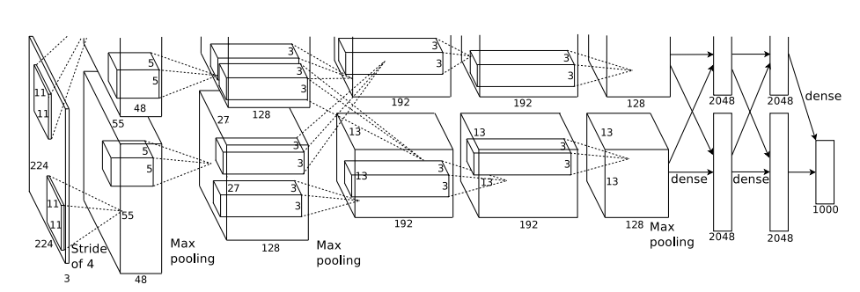
CNN: Case Studies
LeCun, Yann, et al. “LeNet”
Alex, et al. “AlexNet”

Slide 84
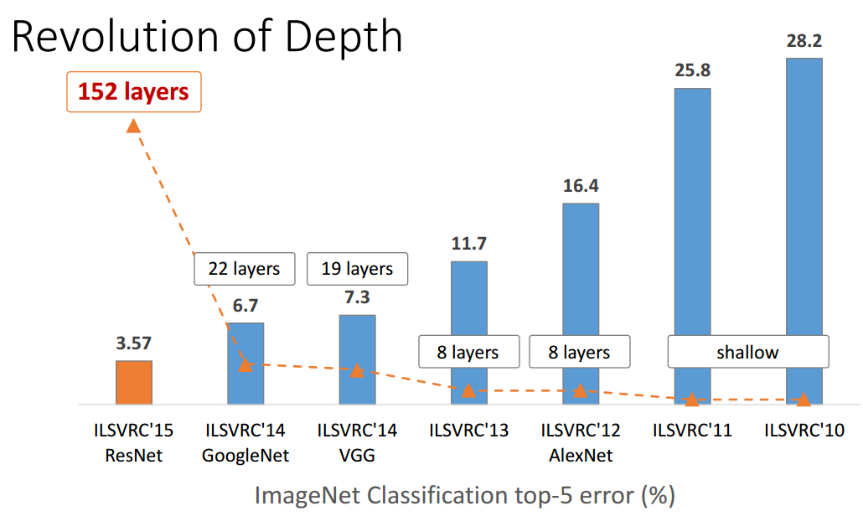
CNN: Case Studies
AlexNet requires 244 MB parameters 1.4. billion floating point operations per image
VGG-16 requires 552 MB of parameters and 30.8 GFLOP per image

Slide 85
State-of-the-art

Slide 86
DNN on an embedded systems
Inference
Training

Slide 87
DNN on an embedded systems
Algorithm
Inference
Training
Hardware

Slide 88
DNN on an embedded systems
Algorithm
Algorithm for Efficient
Inference
Algorithm for Efficient
Training
Inference
Training
Hardware for Efficient
Inference
Hardware for Efficient
Training
Hardware

Slide 89
DNN on an embedded systems
Algorithm
Algorithm for Efficient
Inference
Algorithm for Efficient
Training
Inference
Training
Hardware for Efficient
Inference
Hardware for Efficient
Training
Hardware

Slide 90
Algorithms for Efficient Inference
Quantization
Low Rank Approximation
Winograd Transform
Pruning + Weight Sharing → Deep Compression
Binary / Ternary Neural Network (BNN) (Extreme Quantization)

Slide 91
Quantization
The main idea: Use smaller number of bit width
Suitable for embedded systems
Achieved 4.45 fps on embedded systems using low power
Qiu, Jiantao, et al. "Going deeper with embedded fpga platform for convolutional neural network." Proceedings of the 2016 ACM/SIGDA International Symposium on Field-Programmable Gate Arrays. ACM, 2016.

Slide 92
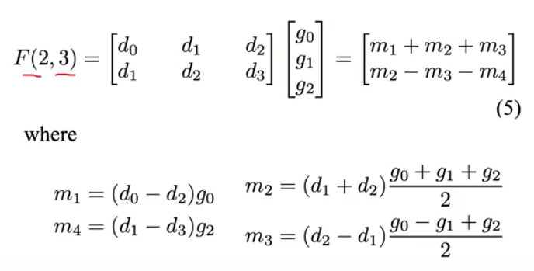
Winograd Transformation
Reducing the number of * operations when computing convolution
[1] Lavin, Andrew, and Scott Gray. "Fast algorithms for convolutional neural networks." CVPR2016.
[2] Aydonat, Utku, et al. "An OpenCL (TM) Deep Learning Accelerator on Arria 10." arXiv preprint arXiv:1701.03534 (2017).

Slide 93
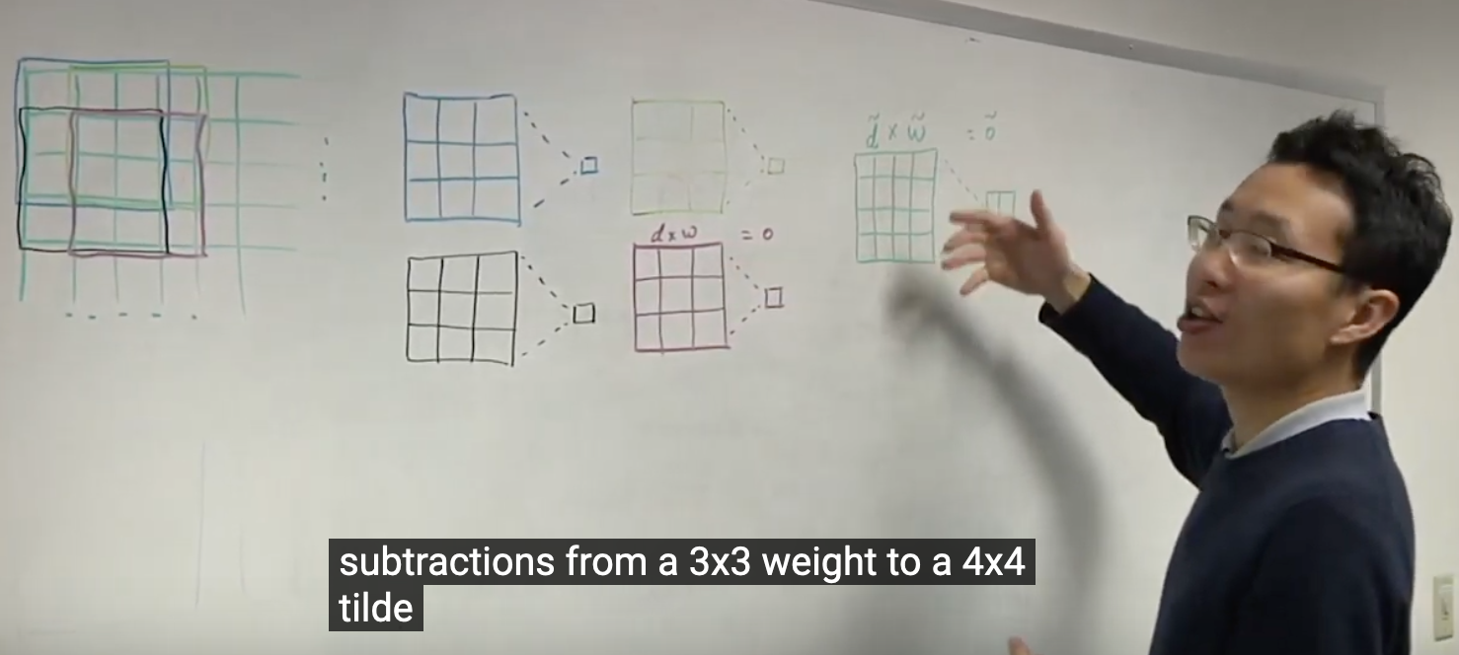
Winograd Transformation
Reducing the number of * operations when computing convolution
https://www.youtube.com/watch?v=E7QJUby9x-I
^ good explainer video
[1] Lavin, Andrew, and Scott Gray. "Fast algorithms for convolutional neural networks." CVPR2016.
[2] Aydonat, Utku, et al. "An OpenCL (TM) Deep Learning Accelerator on Arria 10." arXiv preprint arXiv:1701.03534 (2017).

Slide 94
Winograd Transformation
Implemented AlexNet on Aria FPGA 1150 (6.6 MB)
Efficient data transfer between DRAM and FPGA
Winograd Transformation
Uses OpenCL
Results
1020img/s on ImageNet
[1] Lavin, Andrew, and Scott Gray. "Fast algorithms for convolutional neural networks." CVPR2016.
[2] Aydonat, Utku, et al. "An OpenCL (TM) Deep Learning Accelerator on Arria 10." arXiv preprint arXiv:1701.03534 (2017).
https://www.altera.com/products/fpga/arria-series/arria-10/features.html

Slide 95
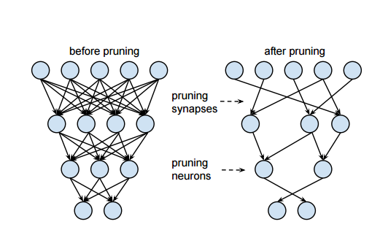
Deep Compression
1) Pruning
[1] S. Han, J. Pool, J. Tran, W.J. Dally, “Learning both Weights and Connections for Efficient Neural Networks”, NIPS’15

Slide 96
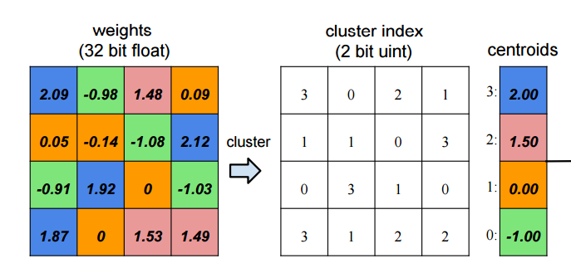
Deep Compression
1) Pruning
2) Weight Sharing
[1] S. Han, J. Pool, J. Tran, W.J. Dally, “Learning both Weights and Connections for Efficient Neural Networks”, NIPS’15.
[2] S. Han, H. Mao, W. J. Dally, “Deep Compression: Compressing Deep Neural Networks with Pruning, Trained Quantization and Huffman Coding”, ICLR’16
[3] S. Han, X. Liu, H. Mao, J. Pu, A. Pedram, M. Horowitz, W. J. Dally, “EIE: Efficient Inference Engine on Compressed Deep Neural Network”, ISCA’16.
[4] F. Iandola, S. Han, M. Moskewicz, K. Ashraf, W. J. Dally, K. Keutzer, “SqueezeNet: AlexNet-Level Accuracy with 50x Fewer Parameters and < 0.5MB Model Size”, arXiv 16

Slide 97
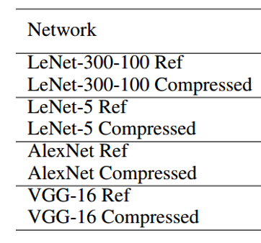
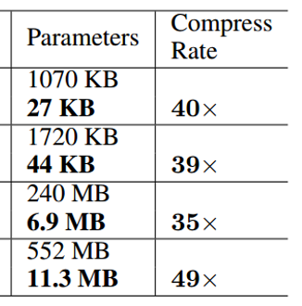
Deep Compression

Slide 98
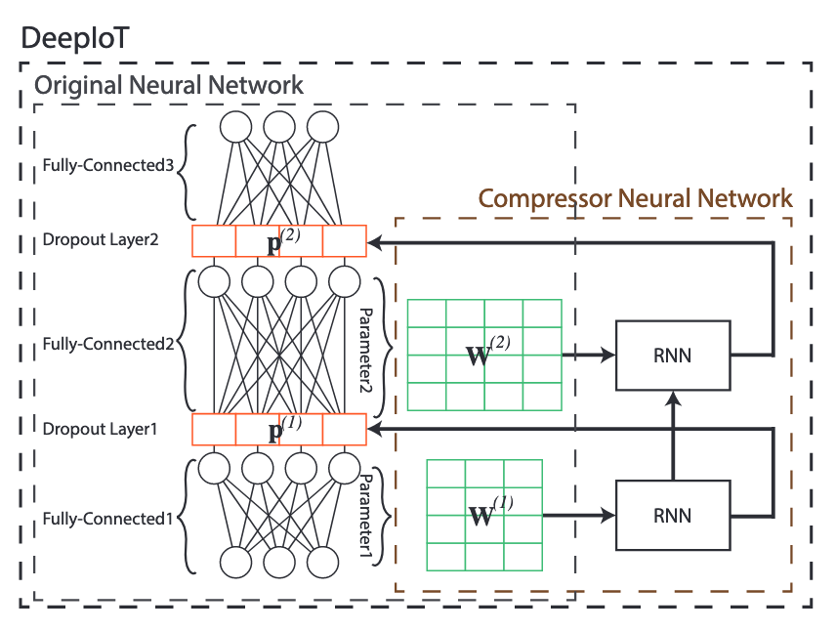
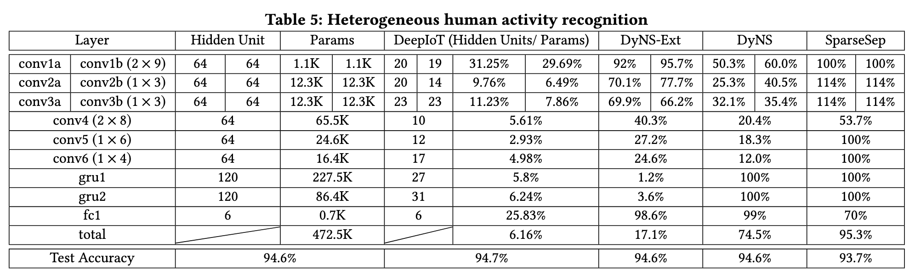
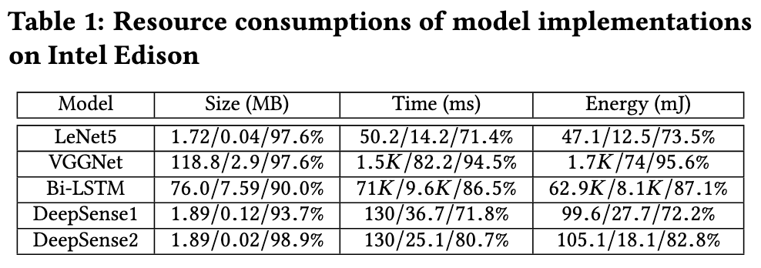
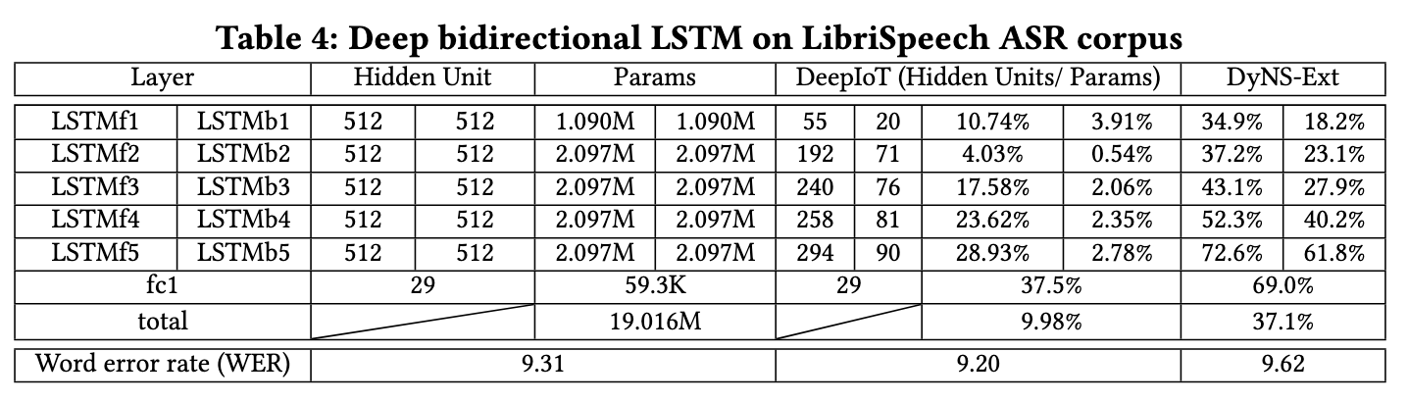
Extremely Deep Compression
Using just 6% of the original network… better accuracy!
https://dl.acm.org/doi/pdf/10.1145/3131672.3131675
Using just 10% of the original network… better accuracy!

Slide 99
5) BinaryConnect & BinaryNet
Courbariaux, Matthieu, Yoshua Bengio, and Jean-Pierre David. "Binaryconnect: Training deep neural networks with binary weights during propagations." Advances in Neural Information Processing Systems. 2015.
Courbariaux, Matthieu, et al. "Binarized neural networks: Training deep neural networks with weights and activations constrained to+ 1 or-1." arXiv preprint arXiv:1602.02830 (2016).

Slide 100
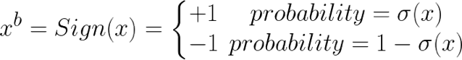

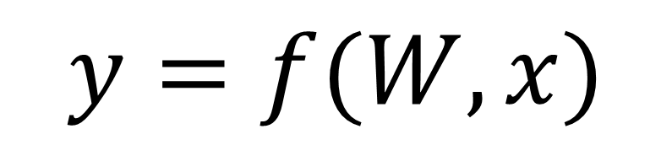
BinaryConnect: Binary Weights
Training
Inference
$$W$$
$$y=f(W,x)$$
+1 / -1

Slide 101
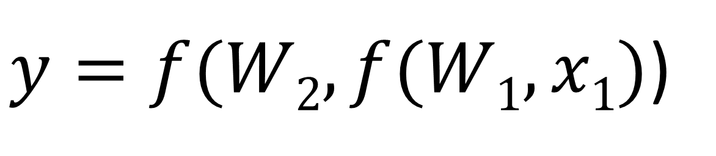
BinaryNet (Binarized Neural Network) BNN
BinaryNet
Binary Input /Output Activations
Binary Weights
$y=f(W2,f(W1,x1)$)
In hardware, matrix multiplication ➔ XNOR & Bitcount operations

Slide 102
Binarized Neural Network
Image
Conv3-64
1. Binary Neural Network (MNIST)
2. Binary Convolutional Neural
Network (CIFAR)
Conv3-64
256-4096
256-4096
256-4096
MP2
784
Conv3-128
Conv3-128
MP2
Conv3-256
Conv3-256
MP2
FC-512
FC-512

Slide 103
BinaryNet (BNN) Results
MNIST
3 hidden units: 4096 neurons each + SVM,
CIFAR
2x128@3x3→ M2→ 2x256@3x3→ M2→2x512@3x3 →M2 → 2x1024 FC → 10SVM
No data augmentation or pre-processing
SVHN
The same (half) of CIFAR
 | MNIST | CIFAR-10 | SVHN
Ordinary DNN | 1.30± 0.04% | 10.64% | 2.44%
BinaryConnect (D) | 1.29±0.08% | 9.90% | 2.30%
BinaryConnect (S) | 1.18±0.04% | 8.27% | 2.15%
BinaryNet | 0.96% | 11.4 | 2.8%

Slide 104
CNV Topology: CIFAR & SVHN
Image
Conv3-64
Conv3-64
MP2
64@3x3x3
64@64x3x3
128@3x3x64
Conv3-128
Conv3-128
32x32x3
MP2
pool
Conv3-256
32x32x64
32x32x64
16x16x64
16x16x128
Conv3-256
MP2
FC-512
FC-512

Slide 105
FINN Conclusion
Work |  | Accuracy | FPS /Latency
FINN | SFC (MNIST) | 95.83% | 12261 K (0.31 us)
FINN | LFC (MNIST) | 98.4% | 1561 K (2.44 us)
FINN | CNV (CIFAR-10) | 80.1%→88% | 21.9 K (283 us)
FINN | CNV (SVHN) | 94.9% | 21.9 K (283 us)

Slide 106
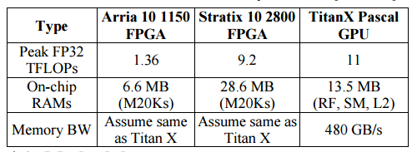
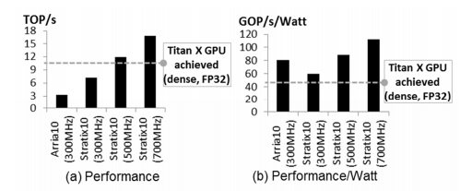
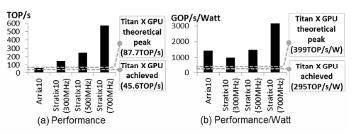
Can FPGA Beat GPUs in Accelerating DNN ?
1) Deep Compression
2) BNN

Slide 107
DNN on an embedded systems
Algorithm
Algorithm for Efficient
Inference
Algorithm for Efficient
Training
Inference
Training
Hardware for Efficient
Inference
Hardware for Efficient
Training
Hardware

Slide 108
DNN on an embedded systems
Algorithm
Algorithm for Efficient
Inference
Algorithm for Efficient
Training
Inference
Training
Hardware for Efficient
Inference
Hardware for Efficient
Training
Hardware

Slide 109
Hardware for Efficient Inference
EIE
Diannao
Eyeriss
DNPU
Minerva
Plethora of academic + industry
[1] Han, Song, et al. "EIE: efficient inference engine on compressed deep neural network." Proceedings of the 43rd International Symposium on Computer Architecture. IEEE Press, 2016.
[2] Chen, Tianshi, et al. "Diannao: A small-footprint high-throughput accelerator for ubiquitous machine-learning." ACM Sigplan Notices. Vol. 49. No. 4. ACM, 2014.
[3] Chen, Yu-Hsin, et al. "Eyeriss: An energy-efficient reconfigurable accelerator for deep convolutional neural networks." IEEE Journal of Solid-State Circuits (2016).
[4] DNPU: An 8.1TOPS/W Reconfigurable CNN-RNN Processor for General-Purpose DeepNeural Network
[5] Reagen, Brandon, et al. "Minerva: Enabling low-power, highly-accurate deep neural network accelerators." Proceedings of the 43rd International Symposium on Computer Architecture. IEEE Press, 2016.

Slide 110
DNN on an embedded systems
Algorithm
Algorithm for Efficient
Inference
Algorithm for Efficient
Training
Inference
Training
Hardware for Efficient
Inference
Hardware for Efficient
Training
Hardware

Slide 111
Algorithm for Efficient Training
Batch Normalization
Model Distilation
DSD
[1] Ioffe, Sergey, and Christian Szegedy. "Batch normalization: Accelerating deep network training by reducing internal covariate shift." arXiv preprint arXiv:1502.03167 (2015).
[2] Romano, Nathanael, and Robin Schucker. "Distilling Knowledge to Specialist Networks for Clustered Classification.“
[3] S. Han, J. Pool, S. Narang, H. Mao, S. Tang, E. Elsen, B. Catanzaro, J. Tran, W. J. Dally, “DSD: Regularizing Deep Neural Networks with Dense-Sparse-Dense Training Flow”, ICLR’17.

Slide 112
DNN on an embedded systems
Algorithm
Algorithm for Efficient
Inference
Algorithm for Efficient
Training
Inference
Training
Hardware for Efficient
Inference
Hardware for Efficient
Training
Hardware

Slide 113
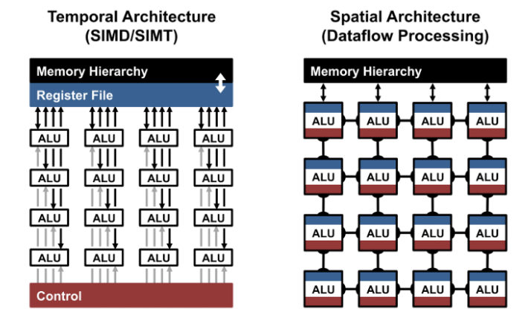
Hardware for Efficient Training
Hardware types
Specific hardware
Nvida Volta 100 with tensor cores
Facebook Big Sur (GPU based)
Distributed training on clusters

Slide 114
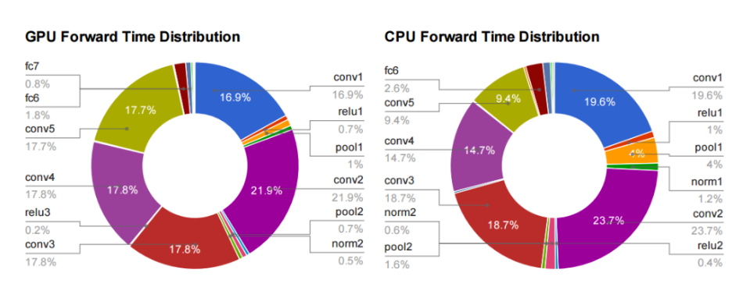
95% of the GPU version, and 89% on CPU is spent on convolutional layers
FPGAs are efficient platforms for convolution, BUT,…!
Jia, Yangqing. "Learning Semantic Image Representations at a Large Scale." (2014).

Slide 115
References
GPU Teaching Kit
https://www.cs.unc.edu/~prins/Classes/633/Readings/CUDA_C_Programming_Guide_4.2.pdf
https://cseweb.ucsd.edu/classes/fa15/cse260-a/lectures.html

